Slide 1
DKubeX 2.0 Architecture

Slide 2




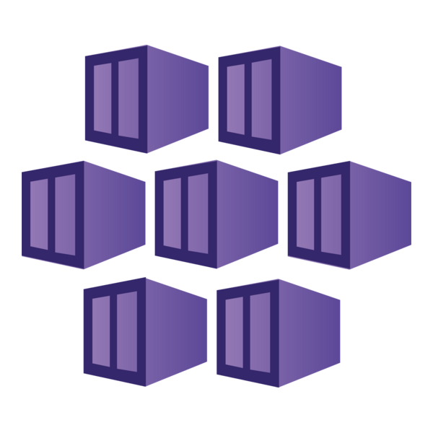



DKubeX 2.0 Architecture
Kubernetes Cluster
Traefik
Auth
DKubeX App Store
MLFlow
RAGFlow
User Interface
Core
Model Studio
SecureLLM
Frontend
Backend
Kopf Operator
LangFlow
AgentX
React + NGINX
FastAPI
Controller
Mortgage-Lite
Law-Lite
Data & Storage
PostgreSQL
Redis
MinIO
NFS Server
Observability
Tools & Admin UIs
OTel Daemonset
ClickStack / HyperDX
Node + Pod Data
Telemetry Backend
HeadLamp
Traefik Dashboard
MinIO Console
HyperDX UI
OTel Deployment
Cluster Telemetry
File Browser
PGAdmin
Infrastructure
Kubernetes:
CPU Nodes
GPU Nodes
dkube.io
Empowering Enterprise AI on Kubernetes

Slide 3

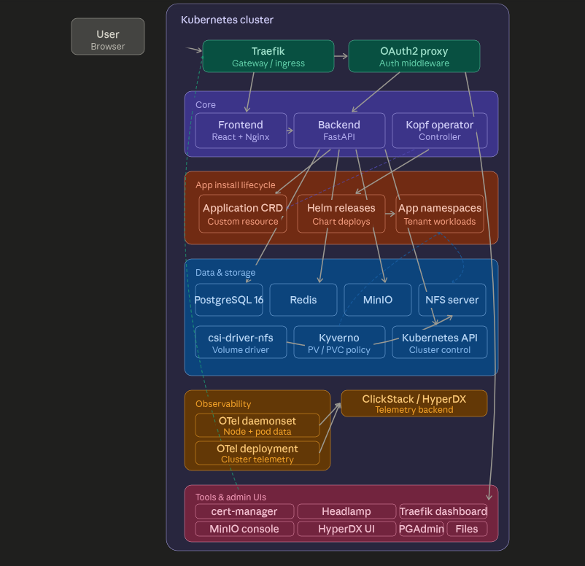
DKubeX 2.0 Architecture
A Kubernetes-native platform for deploying, managing, and operating enterprise AI applications.
Architecture Highlights
Unified UI: Users and admins access DKubeX through a web UI served by the frontend layer.
Secure Entry: Traefik handles ingress routing, while the auth layer protects platform APIs.
Core Plane: Runs React/Nginx frontend, FastAPI backend, and Kopf Operator for reconciliation.
App Store: Centralized Helm-based catalog for MLFlow, RAGFlow, and custom agent apps.
Data Layer: PostgreSQL state, Redis caching, MinIO object storage, and shared NFS.
Observability: OpenTelemetry for data collection with ClickStack/HyperDX for visualization.
Infrastructure: Flexible deployment across cloud (EKS, K3s) or on-prem (CPU/GPU).
dkube.io

Slide 5
DKubeX 2.0 App Store

Slide 6
Application Management and Lifecycle
User Intent
Frontend → Backend (REST/api/v1)
Backend Translates Intent into a Kubernetes Resource
Application Custom Resource (Source of Truth)
Kopf Operator Reconcile Loop (Watches CR Events)
Dependency Provisioning
Status Feedback to the UI
Create Postgres DB + credentials
Create MinIO bucket + access keys
Install From Catalog
POST/applications
Install + role assign
FastAPI Handler
RBAC check, validate
dkubex.io/v1alpha1・namespace dkubex-apps
.spec = chart, version, values・.status.phase = lifecycle state
on.
create
Provision deps before chart runs
Phase Transitions
Pending → Installing → Ready
Label namespace dkubex.io/managed-by
Kyverno auto-generates PV + PVC (NFS)
on.
update
Upgrade Existing App
PUT/applications/{id}
Upgrade chart version
Persist Metadata
Postgres: app + roles
Helm Execution
Live Install Logs
CR conditions + pod logs
on.
delete
Patch .status.phase + conditions
Install・helm install (new release)
Uninstall App
DELETE/applications/{id}
Remove release
Apply Application CR
Create / patch / release
Upgrade・helm upgrade (new values)
UI Poll / Stream
GET install logs・admin
on.
timer
Uninstall・helm uninstall + cleanup
Release pods scheduled in app namespace
dkube.io
Empowering Enterprise AI on Kubernetes

Slide 7
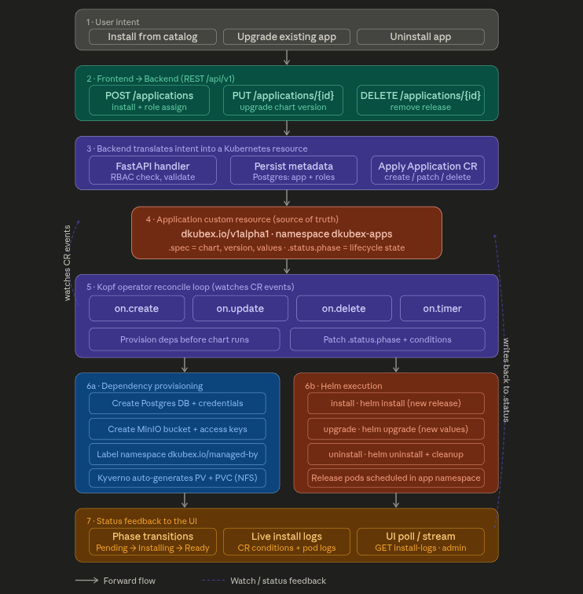

Slide 8
Securellm

Slide 9
SecureLLM Architecture
SecureLLM
Providers
API Layer
Gateway API /v1/*
Admin API /admin/api/*
User UI (SPA)
DKubeX
Chat, Embeddings, Models
Keys, Providers, Usage
Vite + React 18
AI Client/UI
SSO Proxy
oauth2-proxy
Core Engine
OpenAI
Provider Router
Provider Registry
Guardrail Pipeline
Routing Strategy
Circuit Breaker
Pre-call, Post-call
Anthropic
API Layer
API Layer
Health Checker & Model Synchronizer
API Key Cache
Rate Limiter
5 Min TTL
Token Bucket
OpenAI-Compatible
Usage Tracker
Audit Logger
Metrics
SSE Broadcaster
p50 p95 p99
Providers, Routes
Ollama / Custom
SQLite / PostgreSQL
API Keys, Usage Logs, Providers, Routes, Guardrails, Users
dkube.io
Empowering Enterprise AI on Kubernetes

Slide 10
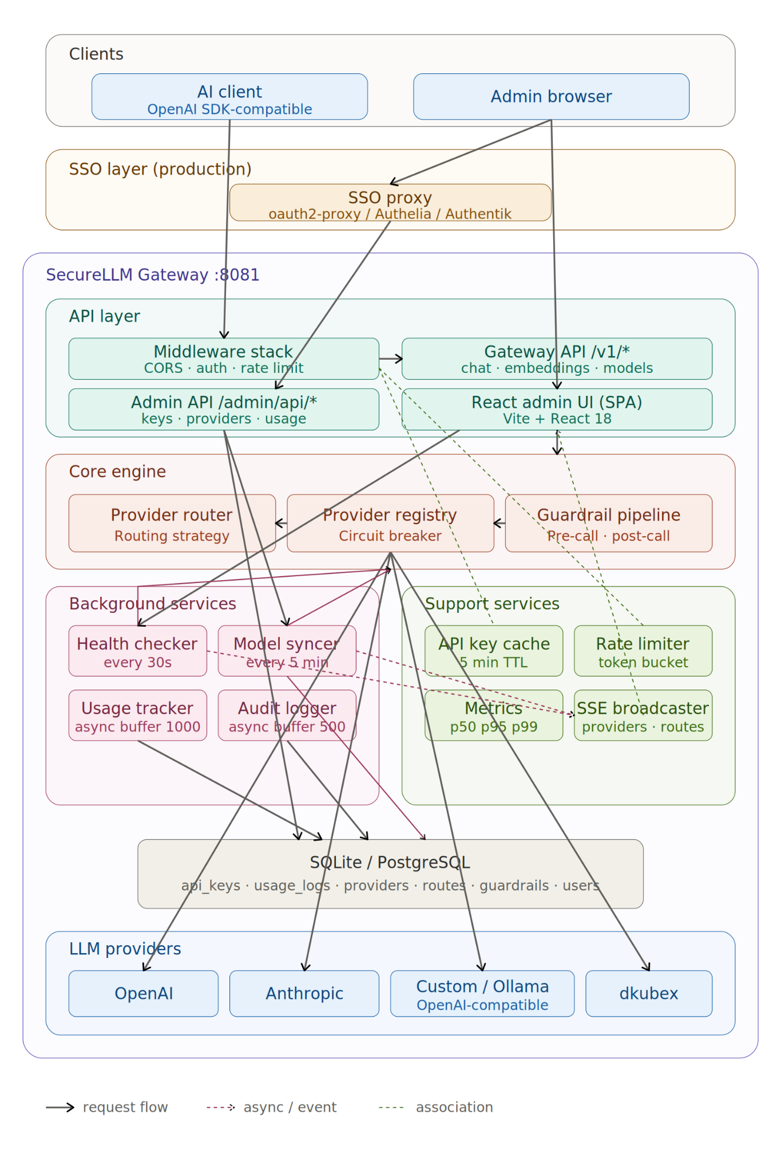

Slide 11
Model studio

Slide 12
ModelStudio Architecture
ModelStudio
Edge / Auth
DKubeX Platform
Traefik
Core
Services
Gateway / Ingress
Frontend
Backend (FastAPI)
Kubernetes API
Cluster Control
User Browser
Pages: Dashboard, Catalog, Deployed, Playground, Settings, MLFlow, ML Registry
Managers: NIM, KServe, Tokens, Models
Postgres 16 (Platform)
ModelStudio DB BE
OAuth2-Proxy
Auth Middleware
MinIO / S3
MLFlow Artifacts
Data & Secrets
ModelStudio DB (Postgres 16)
Kubernetes Secrets
PVCs
NVIDIA GPU Operator
(For Self-Hosted NIM)
HFTokenVault, NimApiKeyVault, NimModelRegistration, ResourceProfile, Activity, ML deploy records
hf-token-{id}
nim-api-key-{id} (NGC_API_KEY + NGC_CLI_API_KEY)
Modelstudio-nim-pull-secret (dockerconfigjson)
kserve-s3-secret・mlflow-secret
NIMCache Storage
RWO・NIM_DEFAULT_PVC_SIZE
(storageClass configurable)
Observability
OTel Daemonset
Node + Pod Telemetry
OTel Deployment
Cluster Telemetry
External (Off-Cluster)
ML / Inference Runtimes
nvcr.io
NIM Registry
ClickStack / HyperDX
Telemetry Backend
KubeAI
KServe + MLFlow
NIM – Self-Hosted
KubeAI Operator
CRD: kubeai.org/v1
Model Engines:
Ollama・vLLM・Infinity・FastWhisper
KServe Controller
GRD: serving.kserve.io/v1beta1
InferenceService Predictors:
Sklearn, xgb, mlflow, huggingface
MLFlow Server + UI
K8s-nim-operator
CRDs: apps.nvidia.com/v1alpha1
NIMCache + NIMService
NIM pods on GPU nodes
Requires GPU Operator + NGC key
Tools & Admin UI
Cert-Manager, Headlamp, Traefik Dashboard, PGAdmin, MinIO Console, HyperDX UI, File Browser
HuggingFace Hub
Model Weights
dkube.io
Empowering Enterprise AI on Kubernetes

Slide 13
